Slide 1



Department Of Electronics And Communication Engineering
Professional Industrial Internship (PII-801)
AI-Enabled Temperature Monitoring and Overheat Prevention System
GROUP MEMBERS:
Vansh Mahajan (2021a4r005)
Basharat Ahmad Khan (2021a3r008)
Sidhant Ujwal (2021a4r007)
Tushar Singh (2021a3r006)
Model Institute of
Engineering & Technology
Notes:
Presentation slide for courses, classes, lectures et al.

Slide 2
Contents
Introduction & problem statement
Literature Review
Objectives
Block Diagram
Components Used
Process Flow
PLC Wiring Layout
Hardware Demonstration
Dashboard
Video Demonstration
References

Slide 3
Introduction & Problem Statement
Introduction:
Overheating of industrial machines like servos premature failures.
Traditional monitoring only reacts to temperature spikes.
Problem Statement:
Need for a predictive system to analyze trends and prevent failures.
Manual temperature monitoring is inefficient and prone to human error.
Lack of real-time alerts leads to unexpected machine breakdowns.

Slide 4
Literature Review
S.No. | Research Paper | Year | Technology Used | Findings | Limitations
1 | Predictive Maintenance of Electric Motors Using Supervised Learning Models: A Comparative Analysis | 2025 | ML (Random Forest, SVM, k-NN…) | Demonstrated high accuracy in classifying motor health states | Focused on lab data; needs field validation
2 | Industrial Robot Control System with Predictive Maintenance Module Using IIoT Technology | 2023 | PLC+IIoT, MQTT, Ethernet, SLMP | Integrated real-time diagnostics with PLC and IIoT for manufacturing robots | No cybersecurity measures; limited to specific robot-PLC setup
3 | Integrating ML for Predictive Maintenance on Resource-constrained PLCs: A Feasibility Study | 2024 | Edge-embedded Neural Networks, acoustic + inductive sensors | Showed that low-power PLCs can infer motor speed and detect faults | Limited to bearing/fan speed; needs expansion to other faults
4 | AI‑Driven Predictive Maintenance and Process Automation in Industrial PLC Systems: Case Study in Oil & Gas | 2018 | AI + PLC + SCADA + ML predictive models | Conceptual framework showing cost savings and automation potential | Theoretical framework; no implementation details or pilot results

Slide 5
Objectives
Monitor multiple industrial parameters (Temperature, Voltage, Current, Humidity, RPM).
Use ESP8266 for environmental and electrical parameters.
Use Mitsubishi iQ-R PLC for actuator control and PT100 sensor.
Visualize data on a local dashboard and implement AI features like:
Predictive maintenance
Health score calculation
Data logging & analysis
Cooling system activation

Slide 6
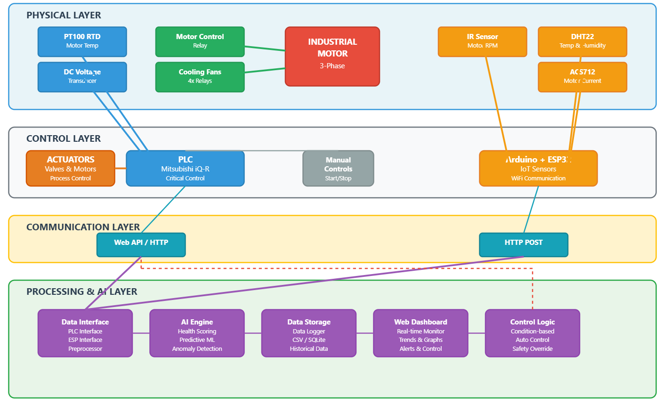
Block Diagram
Figure 1: Block Diagram

Slide 7
Components Used
Hardware
Mitsubishi iQ-R (R00CPU)
PT100 + Transmitter
Voltage Transducer
24V DC Motor
ESP8266
DHT22, ACS712, IR RPM Sensor
Relays, LEDs, PSU, Fan, Buzzer
Software
GX Works3 (Ladder Logic)
Arduino IDE (ESP)
Python + Flask (Web Server & Dashboard)
AI Model.

Slide 8
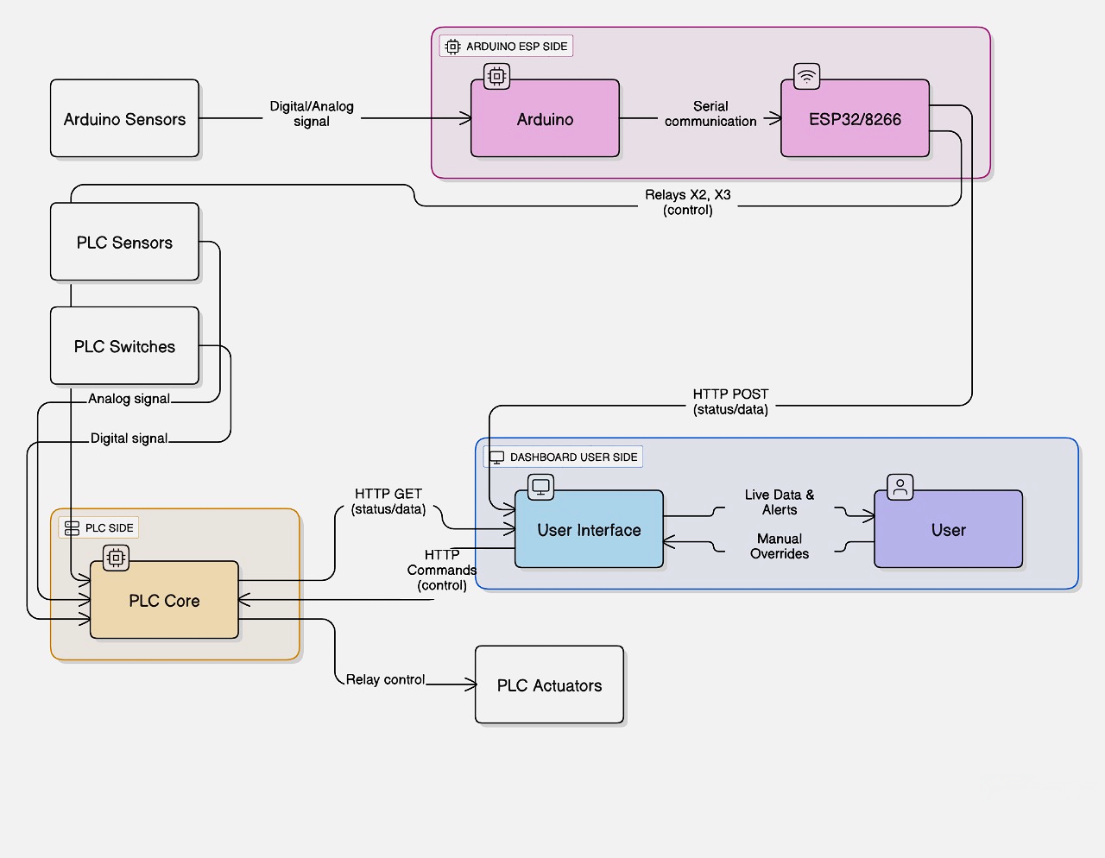
Communication Flow Diagram
Figure 2: Communication flow diagram between PLC, ESP, Arduino, and Python Server

Slide 9
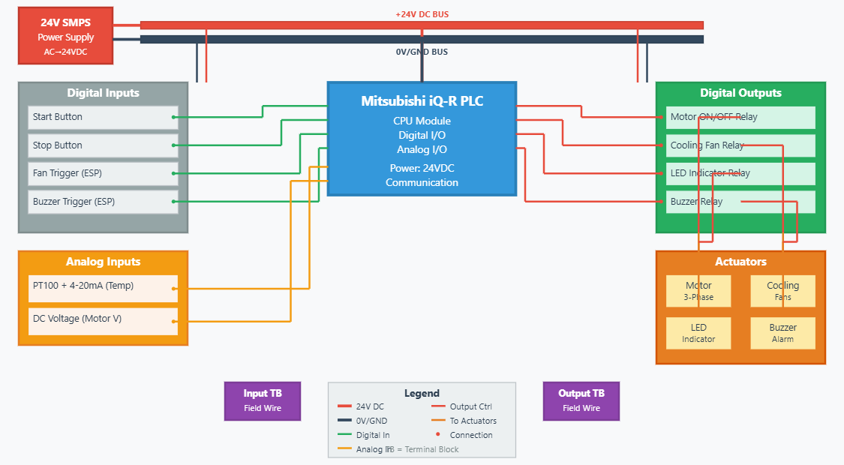
PLC Wiring Layout
Figure 3: Wiring layout of iQ-R PLC

Slide 10
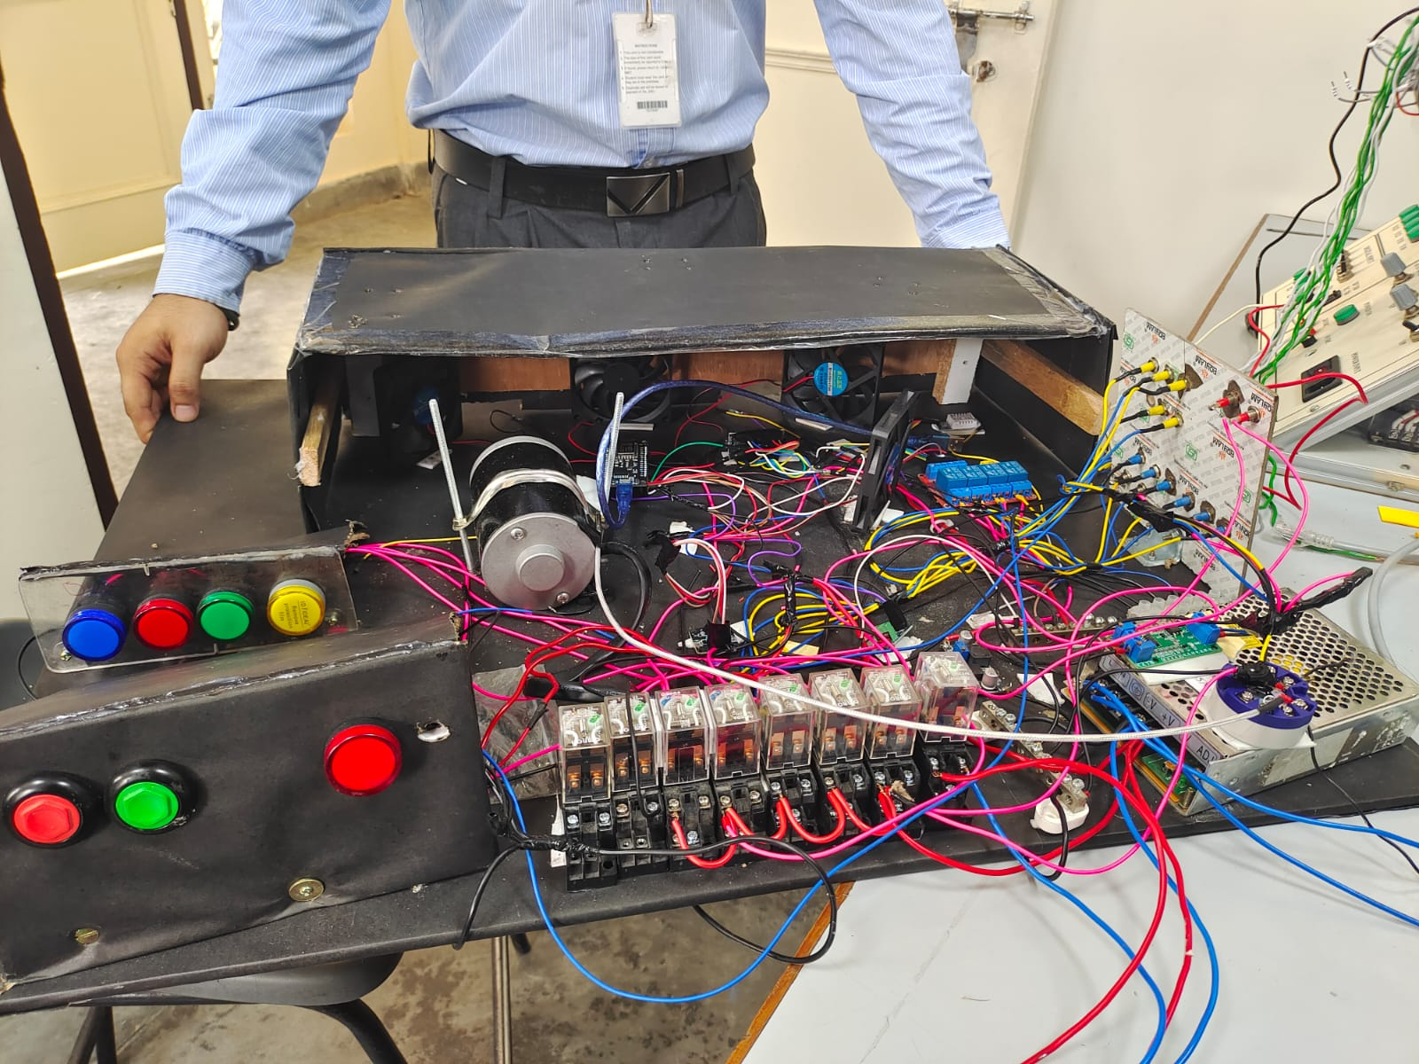
Hardware Demonstration
Figure 4: Hardware Demonstration of the Project

Slide 11
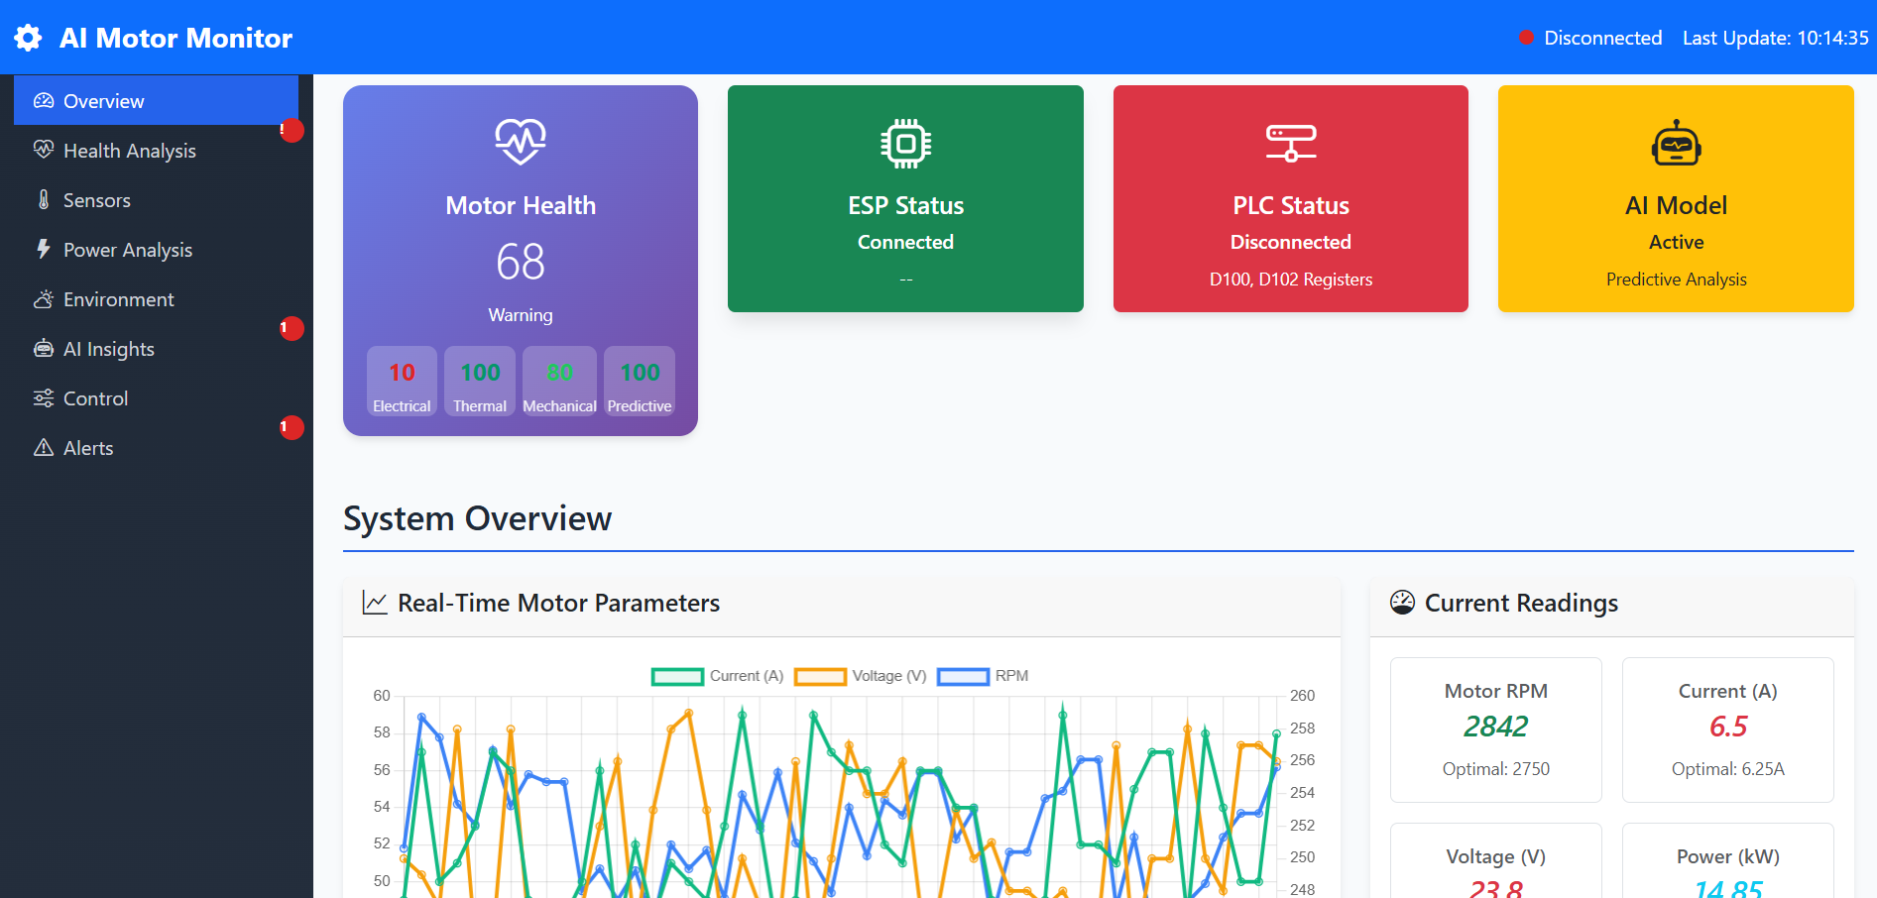
Dashboard
Figure 5: Dashboard

Slide 12
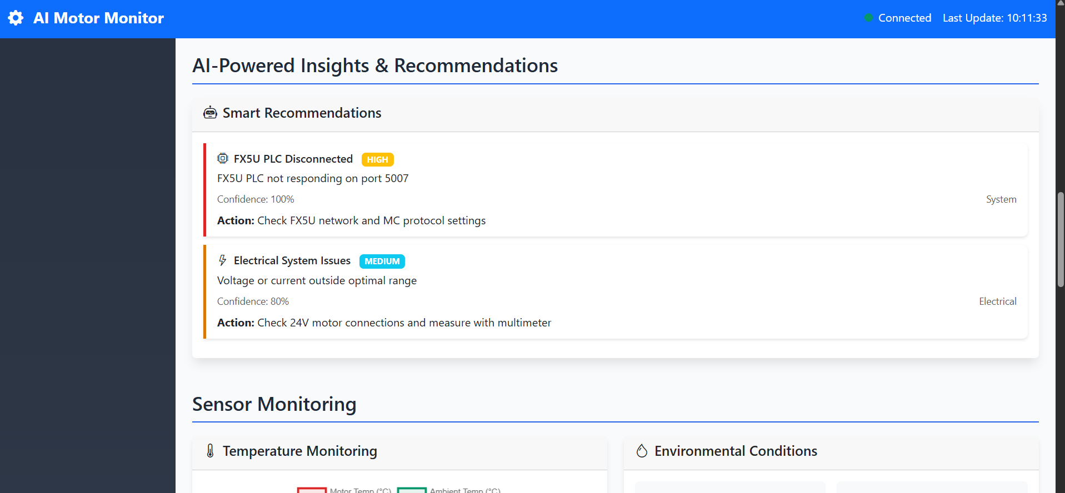
Dashboard
Figure 6: Dashboard

Slide 13
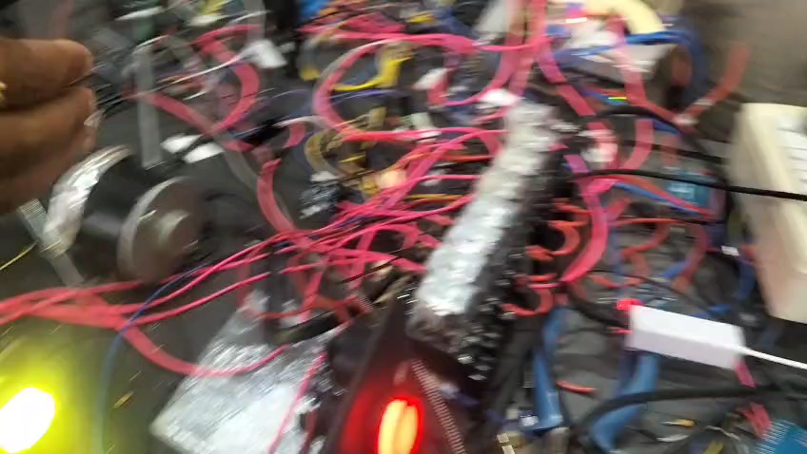
Video Demonstration

Slide 14
References
[1] A. H. Baradaran, “Predictive Maintenance of Electric Motors Using Supervised Learning Models: A Comparative Analysis,” arXiv, Apr. 2025.
[2] M. Galinski, R. Nowak, and S. Kowalski, “Industrial Robot Control System with a Predictive Maintenance Module Using IIoT Technology,” Sensors, vol. 25, no. 4, Mar. 2023.
[3] J. López and P. Santos, “Integrating Machine Learning for Predictive Maintenance on Resource-Constrained PLCs: A Feasibility Study,” Sensors, vol. 25, no. 2, Jan. 2024.
[4] A. B. Kumar and R. Singh, “AI-Driven Predictive Maintenance and Process Automation in Industrial PLC Systems: A Case Study in the Oil and Gas Industry,” Int. J. Core Eng. & Mgmt., vol. 5, no. 9, Dec. 2018.

Slide 15

Thank You

